Slide 1

Null Multilevel Models in R
Psych 741: Hierarchical Linear Modeling

Slide 2
Overview of Tutorial Slides
Importing various file types into R/RStudio (pages 3-9)
Null Multilevel Models
Introduction to lmer() (pages 10-11)
Example Code (page 12)
Example Output (page 13)
P-values (pages 14-16)

Slide 3
Importing Data

Slide 4
Base R functions
read.table()
Imports a file in table format and creates a data frame of it
read.csv()
Imports a comma-separated values (CSV) file
read.csv2()
“variant used in countries that use a comma as decimal point and a semicolon as field separator”
read.delim() and read.delim2()
Imports a tab (i.e., \t) delimited file
The ‘foreign’ package includes functions to import other types of data files, such as read.spss(), read.dta(), and read.xport()

Slide 5
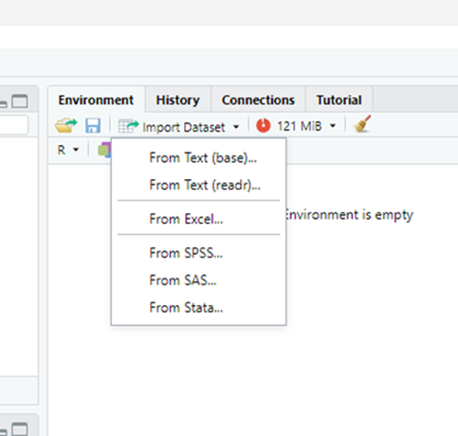
tidyverse Importing Packages/Functions
Text/CSV files
Library: readr
Function: read_csv()
Excel file
Library: readxl
Function: read_excel()
SPSS, SAS, or STATA file
Library: haven
Functions: read_sav(), read_sas(), read_stata()

Slide 6
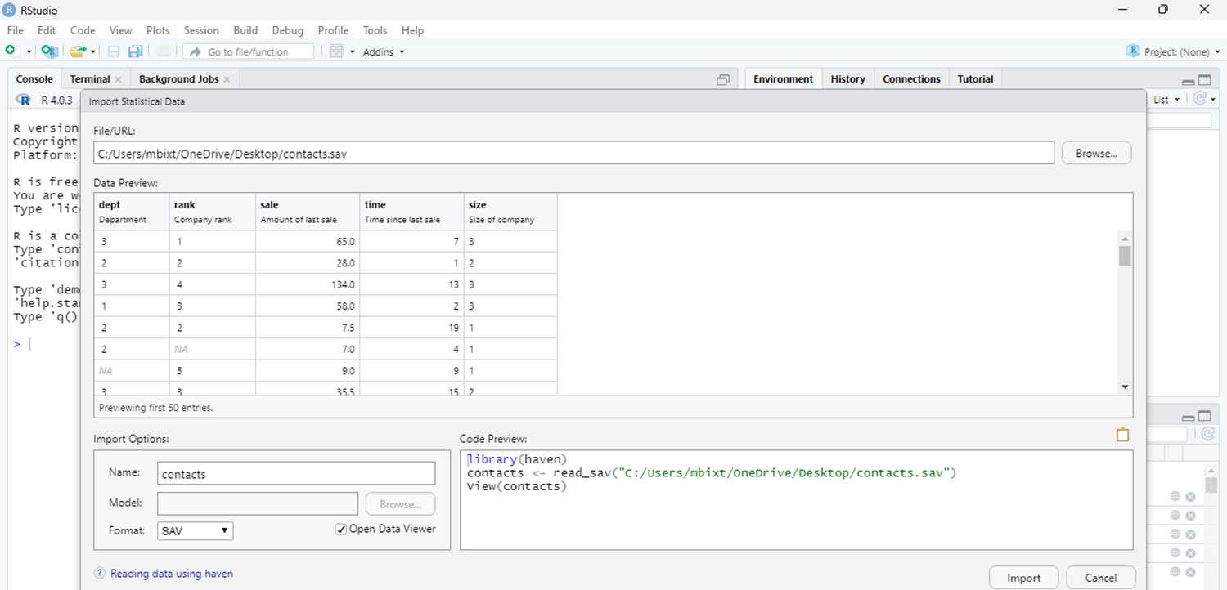
haven – SPSS example
Using the contacts.sav data file on Canvas (Files → Data Sets → SPSS files)

Slide 7
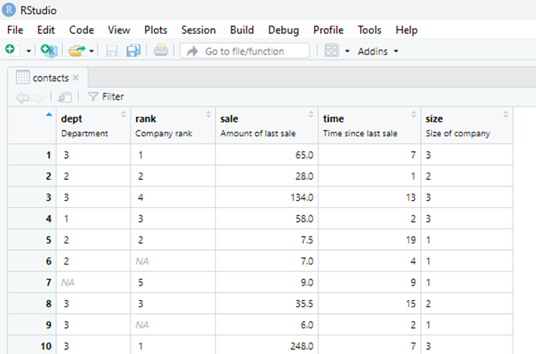
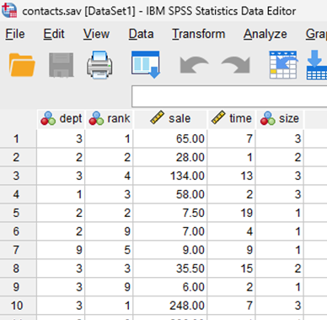
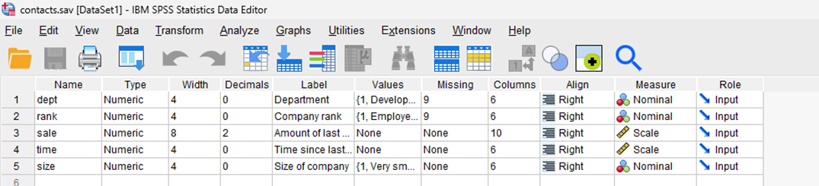
haven – SPSS example
Variable values categorized as missing in the SPSS data file are imported as NA

Slide 8
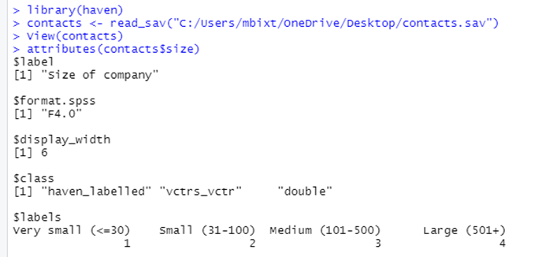
haven – SPSS example
The attributes() function within base R can be used to access the variable and value labels included in the SPSS file

Slide 9
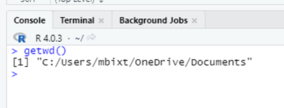
Working Directories
If reading from or writing to a data file directly, R (and most coding languages) will look for or print that file name in the immediate environment (e.g., the desktop, a folder)
The setwd() function can be used to specify a particular location/path on your computer
The getwd() function can be used to check the current working directory

Slide 10

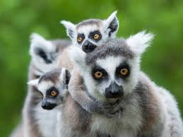
Introduction to lmer()

Slide 11
The lmer() function
The lmer() function derives from the lme4 package
Relevant for Linear Mixed-Effects Regression models
Other packages in R to fit multilevel regression models, such as the nlme package, but they can make different default assumptions

Slide 12
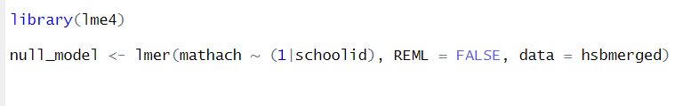
Example Code
Using the hsbmerged.sav data file on Canvas
Sample of 7,185 high school students nested in 160 schools in 1982
Example from the Garson textbook
mathach: the DV (math achievement in this example)
(1|schoolid): the random intercept. Random effects need to be in a parentheses. The 1 makes it a random intercept to be estimated. The variable after the vertical bar (|) is the group/cluster ID variable.
REML = FALSE: the default in lmer() is to use restricted ML. Need to set this to false if you want to use ML.
hsberged: the dataframe name.

Slide 13
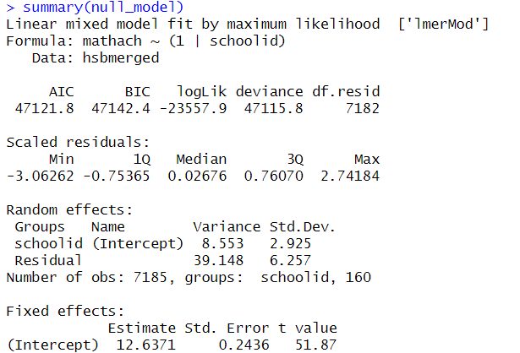
Example Output
Use summary(model name) to print out the results of the multilevel model
-Model fit statistics towards the top
-The random effect presented next along with the residual Level-1 variance
-Fixed effects presented at the bottom

Slide 14
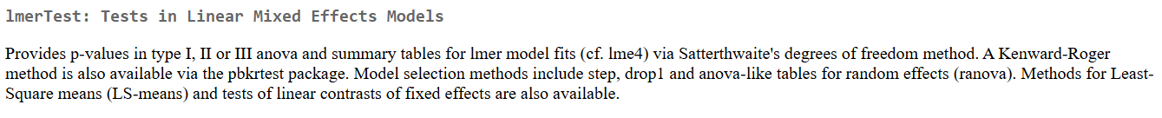
Wait, no p-values???
The appropriate use and interpretation of p-values in multilevel models is debated (in addition to the larger controversy surrounding p-values in general)
The lmerTest package does allow you to estimate p-values for multilevel models. From the documentation of the package:

Slide 15
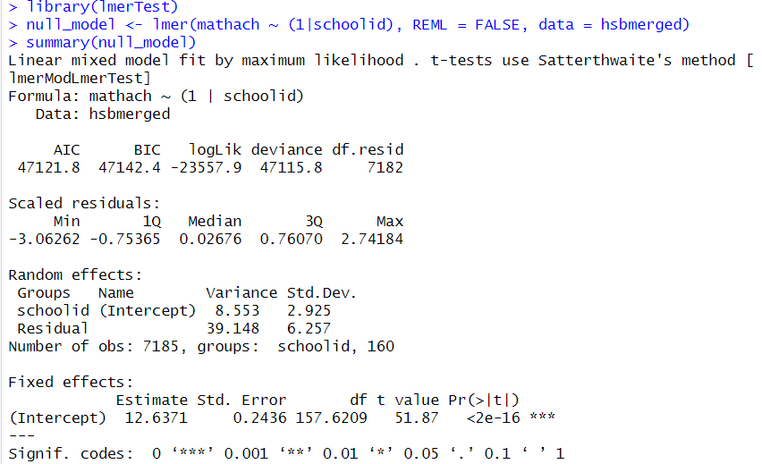
Getting p-values for fixed effects
Make sure the lmerTest package is loaded in your environment before running your model and summary() function

Slide 16
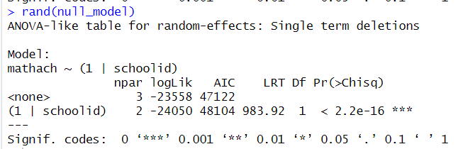
Getting p-values for random effects
Use the rand() function from the lmerTest package

